Slide 1
Fundamentals of Analogue Circuits
Hongling Cui

Slide 2


Fundamentals of Analogue Circuits
INSTRUCTOR: Hongling Cui
1.Email: cuihl@uestc.edu.cn
2.Office: A414 Lab Building
3.Office hours: Monday 4:00 to 6:00 PM
4.Telephone: 61831063

Slide 3
Fundamentals of Analogue Circuits
Overall course grading policies
10% homework and in-class records
15% labs and term project
75% open-book final exam (2 hours)

Slide 4
Fundamentals of Analogue Circuits
Some important rules
Copying or plagiarism of any works (e.g. homework\report) is a violation Code of Academic Integrity and can results “0” grade of the course.
Generally, be present yourself in the lab every time for experiments or project. Or you will be given “0” of the experiments or project.
Follow the rules in lab.

Slide 5
Fundamentals of Analogue Circuits
TEXTBOOK: Microelectronic Circuits, Sedra/Smith, Oxford Publishing
We will cover selected chapters, such as chapter
1、3、4、5、6、7、8、9、10、11
Other Reference Book: Microelectronic Circuits, Sedra/Smith, Oxford Publishing, fifth Edition（中文版）

Slide 6
Fundamentals of Analogue Circuits
Course Objectives:
Chapter 1 Signals and Amplifiers
We will talk about signals and their characterization in the time and frequency domains. And I will introduce the amplifier as circuit building blocks and their various types and models.
Chapter 2 Operational Amplifiers
we will just review their terminal characteristics, simple applications such as inverting amplifier and non-inverting amplifier and so on.

Slide 7
Fundamentals of Analogue Circuits
Course Objectives:
Chapter 3 Semiconductors
1. We will learn about the basic properties of silicon and how doping a pure silicon crystal changes its electrical conductivity.
2. We will learn about the structure and operation of the pn junction; a basic semiconductor structure that implements the diode and plays a dominant role in transistors.

Slide 8
Fundamentals of Analogue Circuits
Course Objectives:
Chapter 4 Diodes
We will learn about the characteristics of the diode and how to abstract it’s model and how to analyze and design circuits containing diodes.
Chapter 5 MOS Field-Effect Transistors (MOSFETs)
We will learn about the physical structure of the MOSFET and how they work. How to abstract their model and how to analyze and design the actual circuits containing them.

Slide 9
Fundamentals of Analogue Circuits
Course Objectives:
Chapter 7 Transistor Amplifiers
we are going to learn the concepts of small-signal operation and modeling.
Chapter 8 Building Blocks of IC Amplifiers
I will introduce a little bit philosophy of IC design. We will learn current mirrors, current sources, gain cells, and cascode amplifiers.
Chapter 9 Differential and Multistage Amplifiers
Chapter 10 Frequency Response
Chapter 11 Feedback

Slide 10
Fundamentals of Analogue Circuits
Discussion:
TOPIC: what’s the difference between discrete circuits and integrated circuits? I'll give you five minutes to figure out it. if you like, you can search the web for that. You can send text messages to answer question.

Slide 11
Fundamentals of Analogue Circuits
Chapter 1: Signals and Amplifiers
Text: Microelectronic Circuits
(From p4 to p51)

Slide 12
Fundamentals of Analogue Circuits
Introduction
IN THIS CHAPTER YOU WILL LEARN…
The Thevenin and Norton representations of signal sources.
The analog and digital representations of a signal.
The representation of a signal as sum of sine waves.

Slide 13
Fundamentals of Analogue Circuits
Introduction
IN THIS CHAPTER YOU WILL LEARN…
How amplifiers are characterized (modeled) as circuit building blocks independent of their internal circuitry.
How the frequency response of an amplifier is measured.

Slide 14
Fundamentals of Analogue Circuits
§1.1 Signals
signal – contains information
e.g. the weather forecast

Slide 15
Fundamentals of Analogue Circuits
§1.1 Signals
signal – contains information
e.g. the weather forecast
process – an operation which allows an observer to understand this information from a signal
generally done electrically
transducer – device which converts signal from non-electrical to electrical form

Slide 16
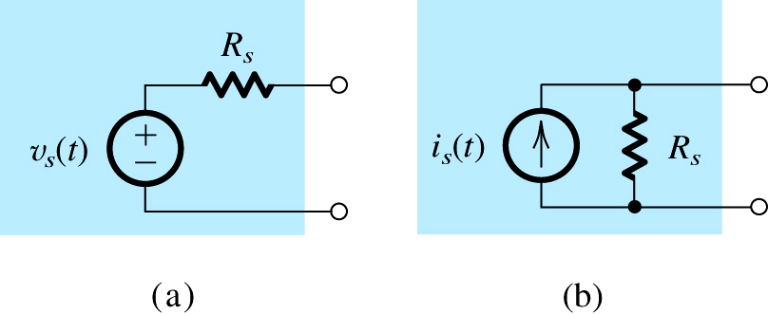
Fundamentals of Analogue Circuits
Q: How are signals represented?
Figure 1.1: Two alternative representations of a signal source:
(a) the Thévenin form; (b) the Norton form.

Slide 17
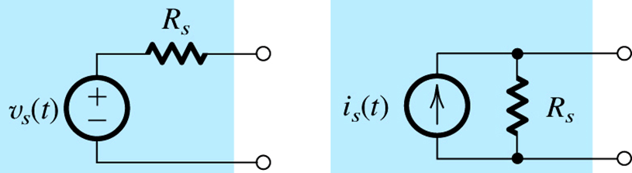
Fundamentals of Analogue Circuits
Q: How are signals represented?
A: Thevenin form – voltage source v_{s}(t) with series resistance R_{S}
preferable when R_{S} is low
A: Norton form – current source i_{s}(t) with parallel resistance R_{S}
preferable when R_{S} is high

Slide 18
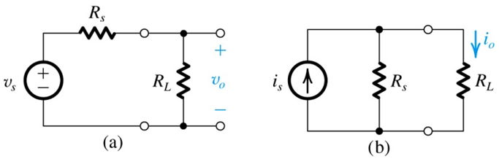
Fundamentals of Analogue Circuits
Example: Consider the signal source when connected to a load resistance R_{L} as shown in below Figure. For the case in which the source is represented by its Thévenin equivalent form, find the voltage v_{o} that appears across R_{L}, and hence the condition that R_{s} must satisfy for v_{o} to be close to the value of v_{s}. Repeat for the Norton-represented source; in this case finding the current i_{o} and hence the condition that R_{s} must satisfy for i_{o} to be close to the value of i_{s}.

Slide 19
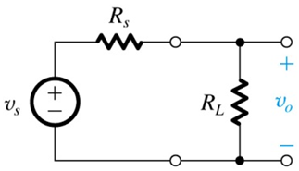
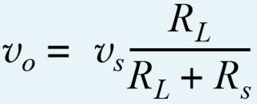


Fundamentals of Analogue Circuits

Slide 20
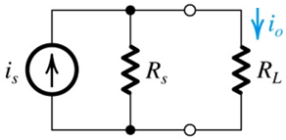
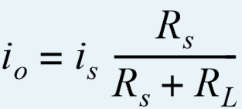


Fundamentals of Analogue Circuits

Slide 21
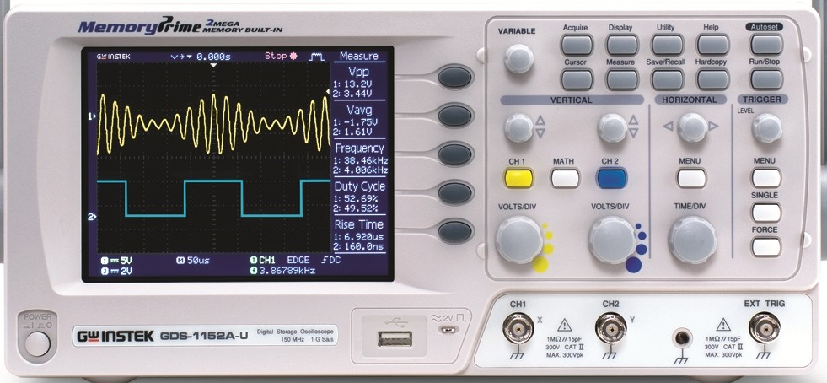
Fundamentals of Analogue Circuits
the oscilloscope

Slide 22
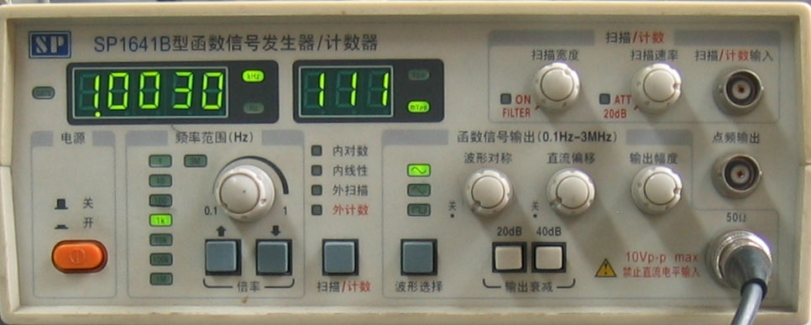
Fundamentals of Analogue Circuits
the Function generator
the signal source has an internal resistance of 50

Slide 23
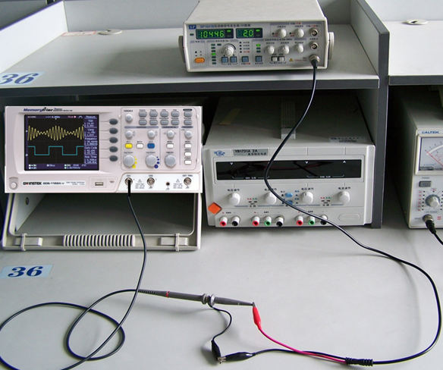
Fundamentals of Analogue Circuits
Q: How to draw the equivalent of this ?
Figure 1.1: Two alternative representations of a signal source:
(a) the Thévenin form; (b) the Norton form.

Slide 24
Fundamentals of Analogue Circuits
The properties of the sinusoid
i(mA)
100
t(ms)
-2.5
O
2.5
5
10
15
20
-100
ω=2πf=2π/T
amplitude
initial phase angle
angular
frequency

Slide 25
Fundamentals of Analogue Circuits
§1.2 Frequency Spectrum of Signals
The properties of the sinusoid
i(mA)
100
t(ms)
-2.5
O
2.5
5
10
15
20
-100

Slide 26
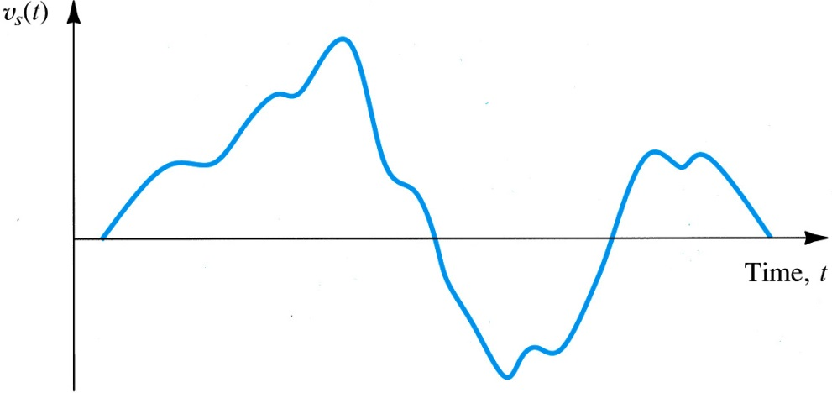
Fundamentals of Analogue Circuits

Slide 27
Fundamentals of Analogue Circuits
§1.2 Frequency Spectrum of Signals
frequency spectrum – defines a time-domain signal in terms of the strength of harmonic components
Q: What is a Fourier Series?
A: An expression of a periodic function as the sum of an infinite number of sinusoids whose frequencies are harmonically related.

Slide 28
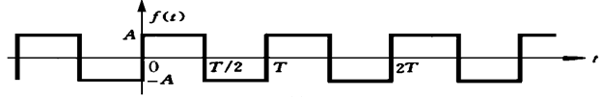
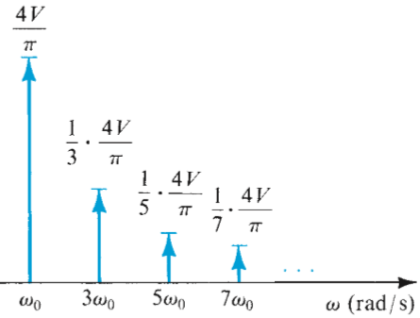
Fundamentals of Analogue Circuits
V
-V

Slide 29
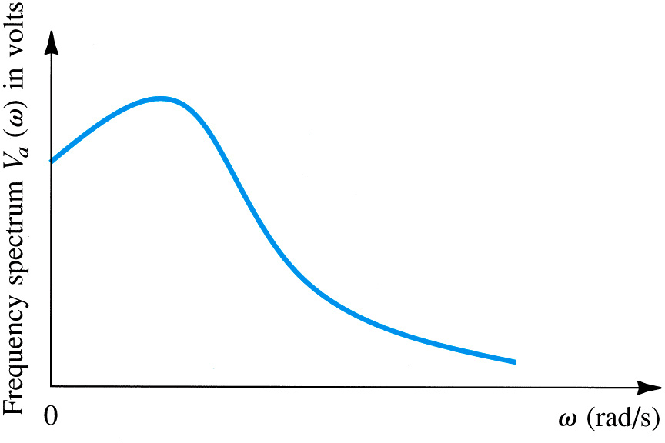
Fundamentals of Analogue Circuits
Q: Can the Fourier Transform be applied to a non-periodic function of time?
A: Yes, however (as opposed to a discrete frequency spectrum) it will yield a continuous…

Slide 30
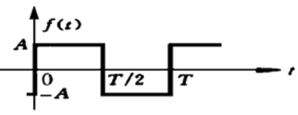
Fundamentals of Analogue Circuits

Slide 31
Fundamentals of Analogue Circuits
§ 1.4 Amplifiers
The most important and fundamental signal-processing task is that of signal amplification.

Slide 32
Fundamentals of Analogue Circuits
§ 1.4 Amplifiers
Q: Why is signal amplification needed?
A: Because many transducers provide output at weak levels (μV-mV).

Slide 33
Fundamentals of Analogue Circuits
§ 1.4 Amplifiers
Q: Why is signal amplification needed?
A: Because many transducers provide output at weak levels (μV-mV).
linearity – is property of an amplifier which ensures a signal is not “altered” from amplification.
distortion – is any unintended change in output.

Slide 34
Fundamentals of Analogue Circuits
1.4.1. Signal Amplification
voltage amplifier – is used to boost voltage levels for increased resolution.
voltage gain

Slide 35
Fundamentals of Analogue Circuits
1.4.1. Signal Amplification
voltage amplifier – is used to boost voltage levels for increased resolution.

Slide 36
Fundamentals of Analogue Circuits
1.4.1. Signal Amplification
voltage amplifier – is used to boost voltage levels for increased resolution.
power amplifier – is used to boost current levels for increased “intensity”.

Slide 37
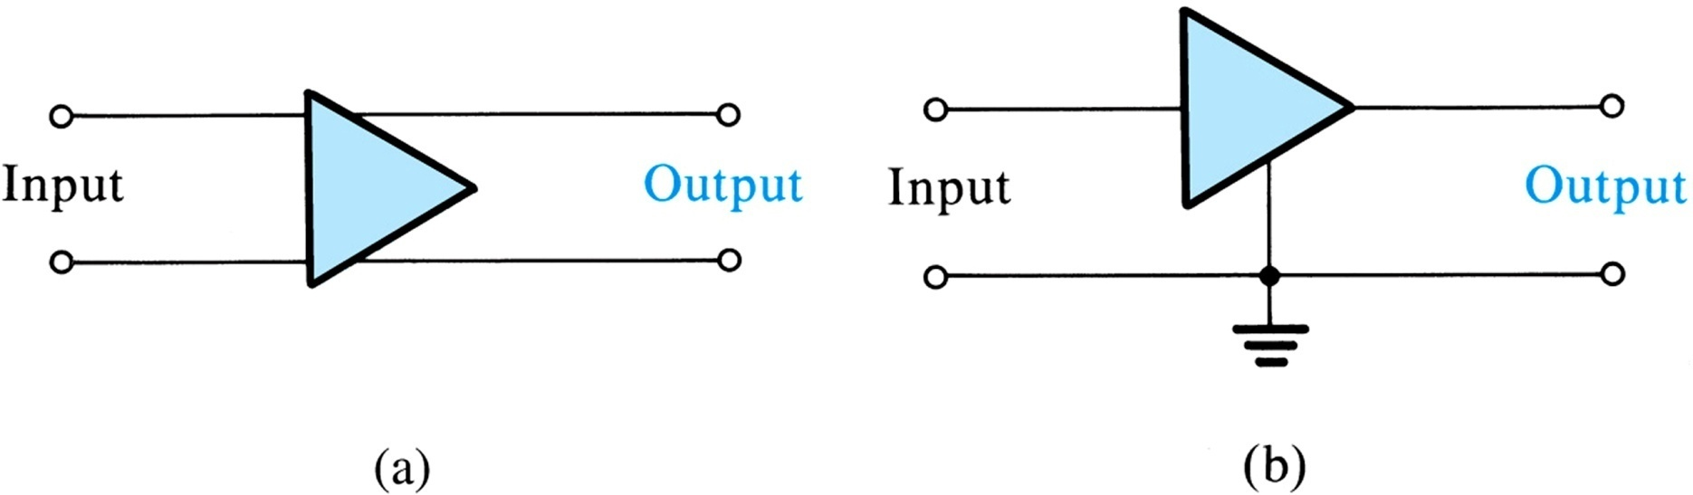
Fundamentals of Analogue Circuits
1.4.2 Amplifier Circuit Symbol
Figure 1.11: (a) Circuit symbol for amplifier. (b) An amplifier with a common terminal (ground) between the input and output ports.

Slide 38
Fundamentals of Analogue Circuits
1.4.2 Amplifier Circuit Symbol
Figure 1.11: (a) Circuit symbol for amplifier. (b) An amplifier with a common terminal (ground) between the input and output ports.

Slide 39
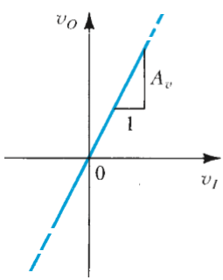
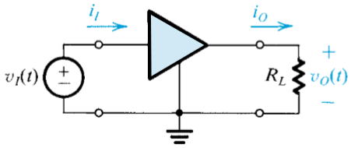
Fundamentals of Analogue Circuits
1.4.3 Voltage Gain
the transfer characteristic of a linear amplifier

Slide 40
Fundamentals of Analogue Circuits
1.4.4 Power and Current Gain
Q: What is one main difference between an amplifier and transformer? …Because both alter voltage levels.
A: Amplifier may be used to boost power delivery.

Slide 41
Fundamentals of Analogue Circuits
1.4.4 Power and Current Gain
Q: What is one main difference between an amplifier and transformer? …Because both alter voltage levels.
A: Amplifier may be used to boost power delivery.

Slide 42
Fundamentals of Analogue Circuits
1.4.5 Expressing Gain in Decibels
Q: How may gain be expressed in decibels?

Slide 43
Fundamentals of Analogue Circuits
1.4.6 The Amplifier Power Supplies
Q: Where does the additional power come from?
A: Amplifiers need dc power supplies for their operation.

Slide 44
Fundamentals of Analogue Circuits
1.4.7 Amplifier Saturation
For an amplifier operated from two power supplies the output voltage cannot exceed a specified positive limit and cannot decrease below a specified negative limit.
amplifiers obey KVL.

Slide 45
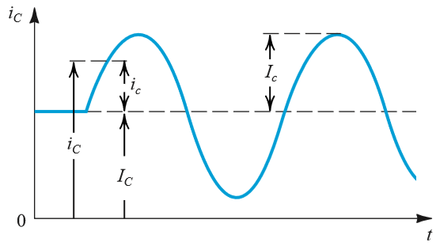
Fundamentals of Analogue Circuits
1.4.8 Symbol Convention
the total instantaneous current i_{C}(t) is the sum of the dc current I_{C} and the signal current i_{c}(t).
Direct-current (dc) quantities
total instantaneous quantities
Incremental signal quantities

Slide 46
Fundamentals of Analogue Circuits
1.4.8 Symbol Convention
a lowercase symbol with uppercase subscript
a lowercase symbol with lowercase subscript
an uppercase symbol with uppercase subscript

Slide 47
Fundamentals of Analogue Circuits
§ 1.5 Circuit Models for Amplifiers
model – is the description of component’s (e.g. amplifier) terminal behavior
neglecting internal operation / transistor design

Slide 48
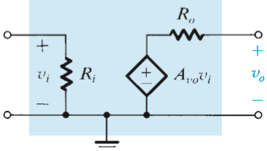
Fundamentals of Analogue Circuits
1.5.1. Voltage Amplifiers

Slide 49
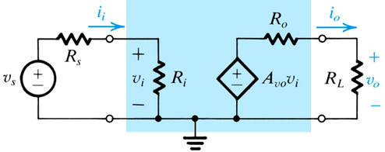
Fundamentals of Analogue Circuits
1.5.1. Voltage Amplifiers

Slide 50
Fundamentals of Analogue Circuits
1.5.1. Voltage Amplifiers

Slide 51
Fundamentals of Analogue Circuits
1.5.1. Voltage Amplifiers
Q: How can one model the amplifier behavior from previous slide?
A: Model which is function of: v_{s}, A_{vo}, R_{i}, R_{s}, R_{o}, R_{L}

Slide 52
Fundamentals of Analogue Circuits
1.5.1 Voltage Amplifiers
Q: What is one “problem” with this behavior?
A: Gain (ratio of v_{o} and v_{s}) is not constant, and dependent on input and load resistance.
The ideal amplifier model neglects this nonlinearity.

Slide 53
Fundamentals of Analogue Circuits
1.5.1. Voltage Amplifiers

Slide 54
Fundamentals of Analogue Circuits
1.5.1. Voltage Amplifiers
ideal amplifier model – is function of v_{s} and A_{vo} only!!
It is assumed that R_{o} << R_{L}…
It is assumed that R_{s} << R_{i} …
key characteristics of ideal voltage amplifier model = source resistance R_{S} and load resistance R_{L} have no effect on gain

Slide 55
Fundamentals of Analogue Circuits
1.5.2 Cascaded Amplifiers
In real, an amplifier is not ideal and will not have infinite input impedance or zero output impedance.
Cascading of amplifiers, however, may be used to emphasize desirable characteristics.
first amplifier – high R_{i}, medium R_{o}
last amplifier – medium R_{i}, low R_{o}
aggregate – high R_{i}, low R_{o}

Slide 56
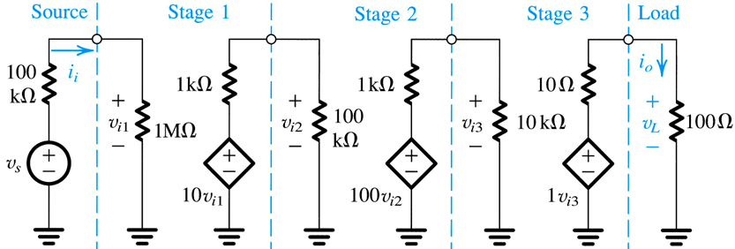
Fundamentals of Analogue Circuits
Example 1.3: Cascaded Amplifier Configurations
Fig 1.17 depicts an cascaded amplifier of three stages
Q(a): What is overall voltage gain?
Q(b): What is overall current gain?
Q(c): What is overall power gain?

Slide 57
Fundamentals of Analogue Circuits
Example 1.3: Cascaded Amplifier Configurations
solution

Slide 58
Fundamentals of Analogue Circuits
Example 1.3: Cascaded Amplifier Configurations
Step #2

Slide 59
Fundamentals of Analogue Circuits
Example 1.3: Cascaded Amplifier Configurations
Step #3

Slide 60
Fundamentals of Analogue Circuits
Example 1.3: Cascaded Amplifier Configurations
Step #4

Slide 61
Fundamentals of Analogue Circuits
Example 1.3: Cascaded Amplifier Configurations
Step #5

Slide 62
Fundamentals of Analogue Circuits
The current gain is found as follows:

Slide 63



Fundamentals of Analogue Circuits
The power gain is found from

Slide 64
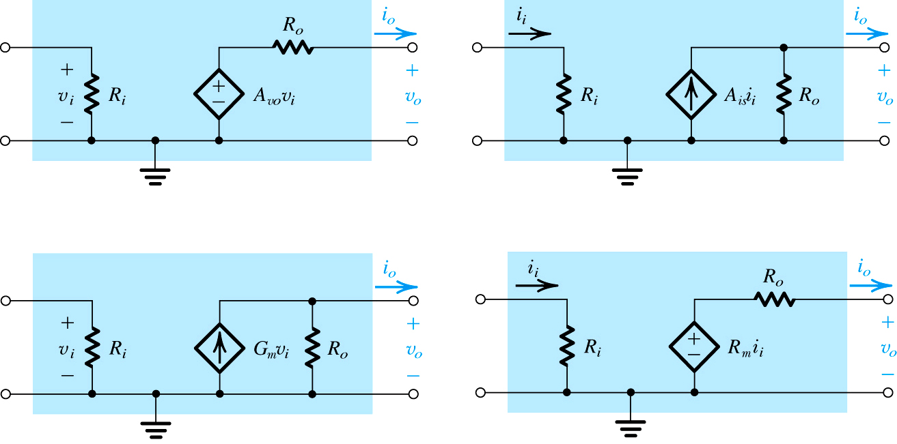
Fundamentals of Analogue Circuits
1.5.3 Other Amplifier Types
voltage amplifier
current amplifier
transconductance amp
transresistance amp

Slide 65
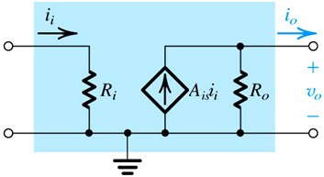
Fundamentals of Analogue Circuits
current amplifier

Slide 66
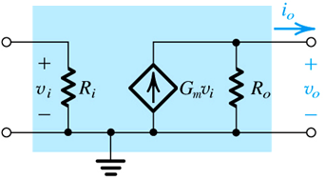
Fundamentals of Analogue Circuits
current amplifier
transconductance amplifier

Slide 67
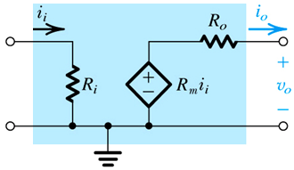
Fundamentals of Analogue Circuits
1.5.3 Other Amplifier Types
transresistance amplifier

Slide 68
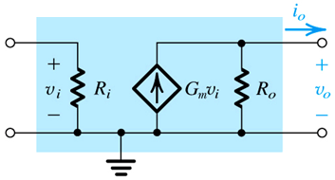
Fundamentals of Analogue Circuits
1.5.4 Relationship Between Four Amp Models
interchangeability – although these four types exist, any of the four may be used to model any amplifier
they are related through A_{vo} (open circuit gain)

Slide 69

Fundamentals of Analogue Circuits
1.5.5. Determining R_{i} and R_{o}
Q: How can one calculate input resistance from terminal behavior?
A: Observe v_{i} and i_{i}, calculate via R_{i} = v_{i} / i_{i}

Slide 70
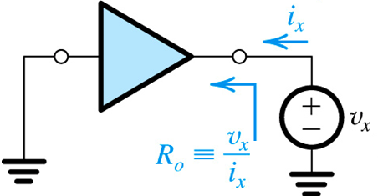
Fundamentals of Analogue Circuits
1.5.5. Determining R_{i} and R_{o}
Q: How can one calculate output resistance from terminal behavior?
A:Remove source voltage (such that v_{i} = i_{i} = 0)
Apply voltage to output (v_{x})
Measure negative output current (-i_{o})
Calculate via R_{o} = -v_{x} / i_{x}

Slide 71
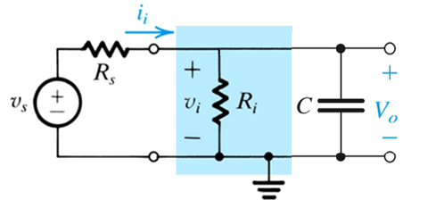
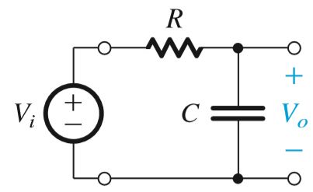
Fundamentals of Analogue Circuits
1.6 Frequency Response of Ampliﬁers
Frequency response techniques find wide applications in communication, control, and instrumentation systems. The key component in these applications is the electric filter.
Q: What type of filter is this circuit?
A: all pass filter.
A: low pass filter.

Slide 72
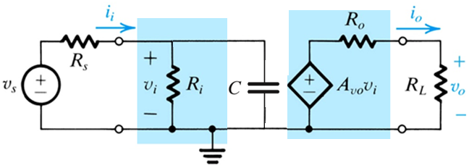
Fundamentals of Analogue Circuits

Slide 73
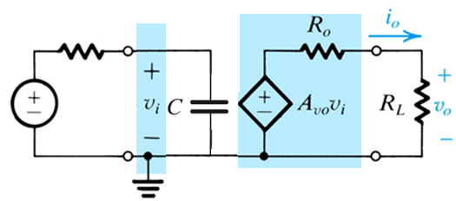
Fundamentals of Analogue Circuits
R_{s} // R_{i}

Slide 74
Fundamentals of Analogue Circuits
R_{s} // R_{i}

Slide 75
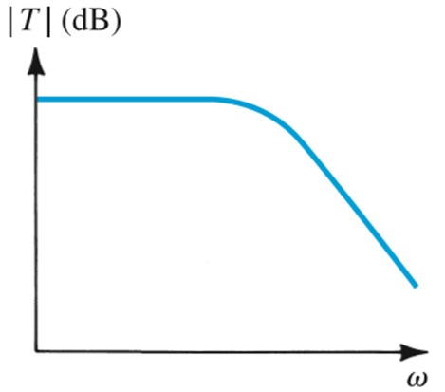
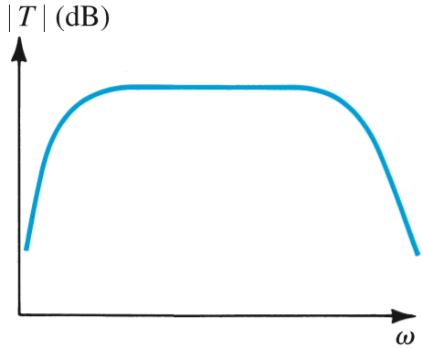
Fundamentals of Analogue Circuits

Slide 76
Fundamentals of Analogue Circuits
1.6.1 Measuring the Amplifier
Frequency Response
Q: How does one examine frequency response?
A: By applying sine-wave input of amplitude V_{i} and frequency ω.
Q: Why?
A: Because, although its amplitude and phase may change, its shape and frequency will not.
this characteristic of sine wave applied to
linear circuit is unique.

Slide 77
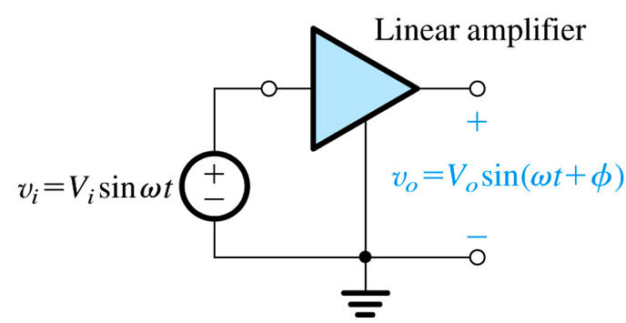
Fundamentals of Analogue Circuits
1.6.1 Measuring the Amplifier Frequency Response

Slide 78
Fundamentals of Analogue Circuits
1.6.1 Measuring the Amplifier Frequency Response

Slide 79
Fundamentals of Analogue Circuits
Conclusion
An electrical signal source can be represented in either Thevenin form (a voltage source v_{s} in series with source resistance R_{s}) or the Norton form (a current source i_{s} in parallel with resistance R_{s}).
The Thevenin voltage v_{s} is the open-circuit voltage between the source terminals. The Norton current i_{s} is equal to the short-circuit current between the source terminals. For the two representations to be equivalent, v_{s} and R_{s}i_{s} must be equal.

Slide 80
Fundamentals of Analogue Circuits
Conclusion
A signal can be represented either by its waveform vs time or as the sum of sinusoids. The latter representation is known as the frequency spectrum of the signal.
Analog signals have magnitudes that can assume any value. Electronic circuits that process analog signals are called analog circuits. Sampling the magnitude of an analog signal at discrete instants of time and representing each signal sample by a number results in a digital signal. Digital signals are processed by digital circuits.

Slide 81
Fundamentals of Analogue Circuits
Conclusion
Amplifiers increase the signal power and thus require dc power supplies for their operation.
The amplifier voltage gain can be expressed as a ratio A_{v} in V/V or in decibels, 20log|A_{v}| in dB.

Slide 82
Fundamentals of Analogue Circuits
Conclusion
Depending on the signal to be amplified (voltage or current) and on the desired form of output signal (voltage or current) there are four basic amplifier types: voltage, current, transconductance, and transresistance. A given amplifier may be modeled by any of these configurations, in which case their parameters are related by (1.14) through (1.16) in the text.

Slide 83
Fundamentals of Analogue Circuits
Homework

Slide 84
Fundamentals of Analogue Circuits
Homework
1.43 1.44 1.48 1.51 1.55 1.56

